Slide 1
Exploring Compound Combinations in High Throughput Settings Going Beyond 1D Metrics
Rajarshi Guha
NCATS
June 2014, Novartis, Boston.

Slide 2
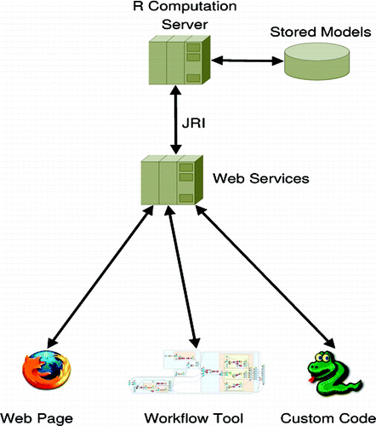
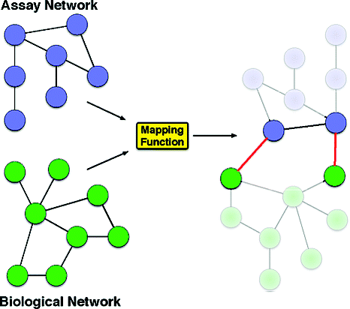
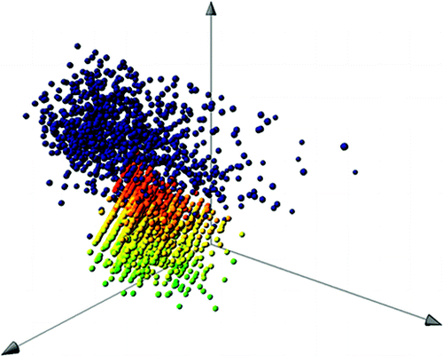
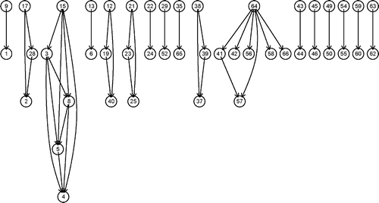

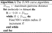
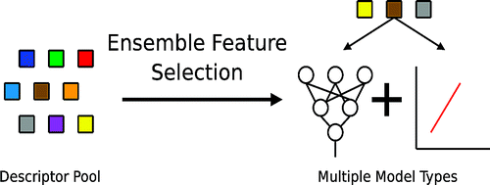
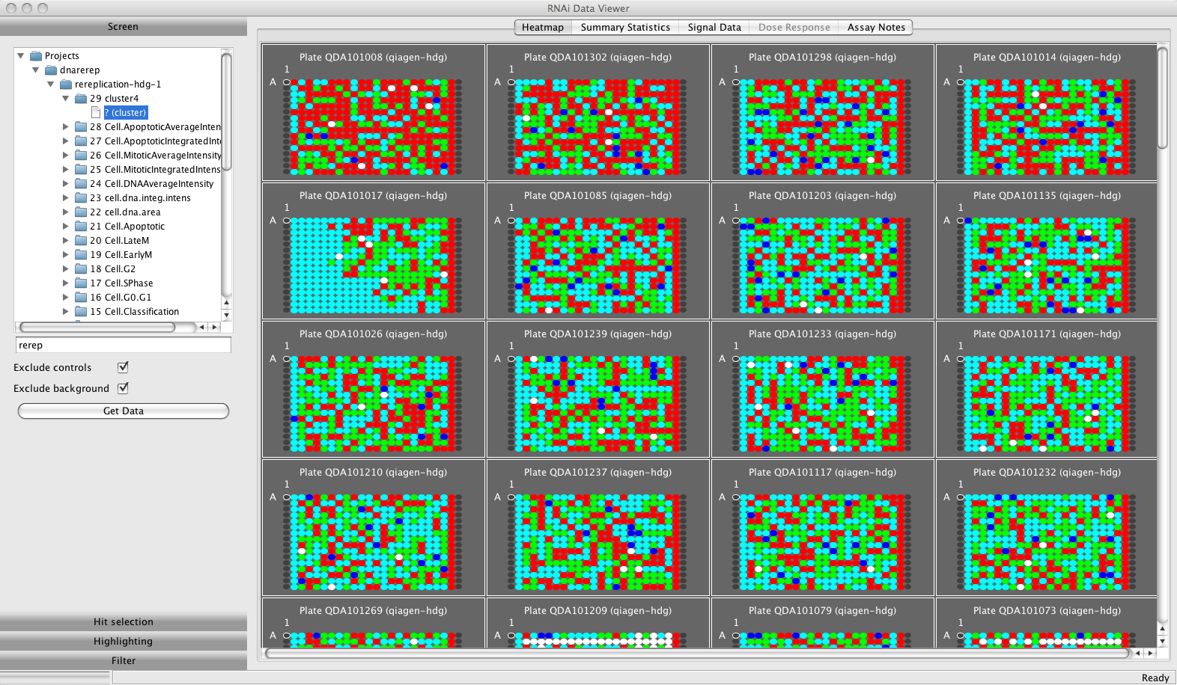
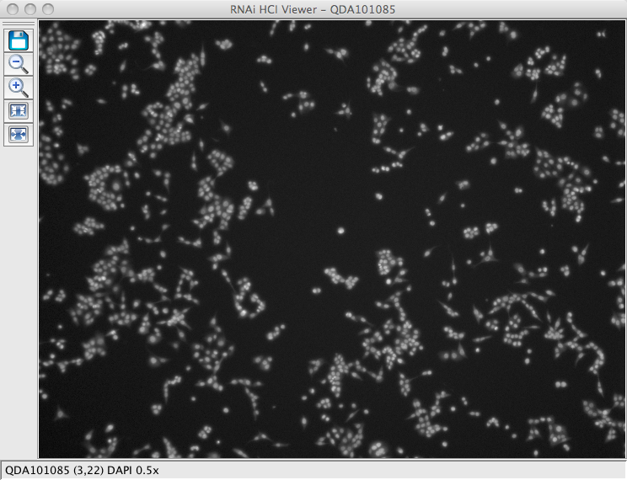
Background
Cheminformatics methods
QSAR, diversity analysis, virtual screening, fragments, polypharmacology, networks
More recently
RNAi screening, high content imaging, combination screening
Extensive use of machine learning
All tied together with software development
User-facing GUI tools
Low level programmatic libraries, APIs, databases
Believer & practitioner of Open Source

Slide 3
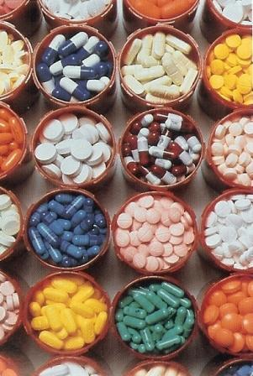
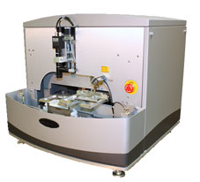
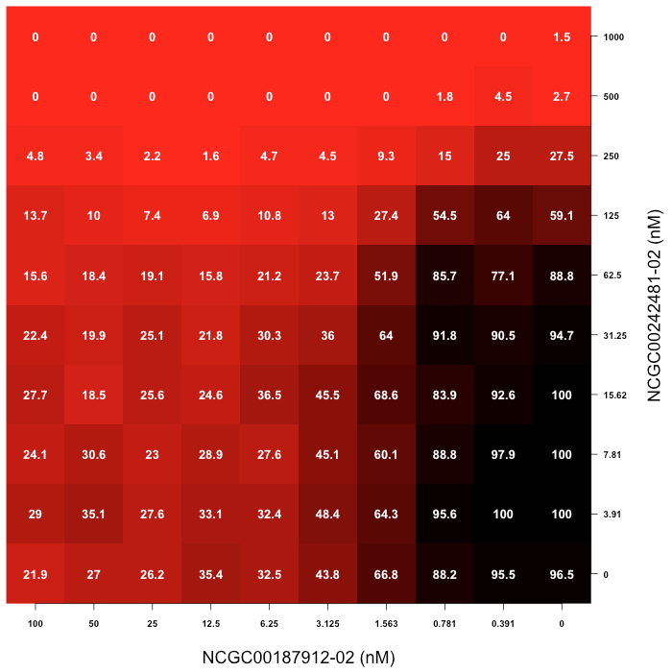
Outline
Why combine?
Physical infrastructure & workflow
Summarizing and exploring the data
http://origin.arstechnica.com/news.media/pills-4.jpg

Slide 4
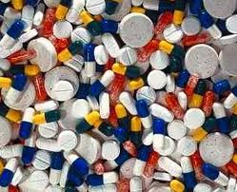
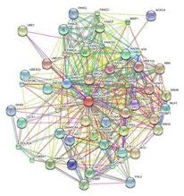
Screening for Novel Drug Combinations
Translational Interest
Basic Interest
Increased efficacy
Delay resistance
Attenuate toxicity
Inform signaling pathway connectivity
Identify synthetic lethality
Highlight polypharmacology
Notes:
Standards of care for many diseases are now drug combinations
A collection of small molecules with defined cellular mechanism
Solve technical challenges in compound plating and automated data analysis & visualization
Clinical relevance is a priority

Slide 5
How to Test Combinations
Many procedures described in the literature
Fixed dose ratio (aka ray)
Ray contour
Checkerboard
Genetic algorithm

Slide 6

Mechanism Interrogation PlateE
Collection of ~ 2000 small molecules of diverse mechanism of action.
745 approved drugs
420 phase I-III investigational drugs
767 preclinical molecules
Diverse and redundant MOAs represented
JZL-184
MAGL inhibitor
Preclinical
GSK-1995010
FAS inhibitor
Preclinical
belinostat
HDAC inhibitor
Phase II
JNJ-38877605
HGFR inhibitor
Phase I
AMG-47a
Lck inhibitor
Preclinical
Eliprodil
NMDA antagonist
Phase III
Notes:
Focuses on oncology, malaria and infectious diseases, stem cell biology
209 unique targets
159 unique KEGG targets

Slide 7
Mechanism Interrogation PlateE
Top 10 enriched GeneGo pathway maps
Notes:
Focuses on oncology, malaria and infectious diseases, stem cell biology
209 unique targets
159 unique KEGG targets

Slide 8
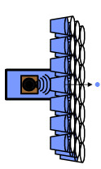
Combination Screening Workflow
Run single agent dose responses
6x6 matrices for
potential synergies
10x10 for confirmation + self-cross
Acoustic dispense, 15 min for 1260 wells, 14 min for 1200 wells
Notes:
Once we have the combination responses, many well known ways to characterize presence/absence of synergy (Loewe, Gaddum, Bliss etc)

Slide 9
Where Are We Now?
382 screens in total
65,960 combinations
3,024,224 wells
244 cell lines
Various cancers
Mainly human
Combined with target annotations we can look at combination behavior as a function of various factors

Slide 10
Screening Challenges
A key challenge is automated quality control
Plate level data employs standard metrics focusing on control performance
Combination level is more challenging
Single agent performance is one approach
MSR across all combination can provide a high level view
But how to identify bad blocks?

Slide 11
QC Examples
Investigating anti-malarial combinations
300 10x10 combinations in duplicate
15 compounds included more than ten times

Slide 12
QC Examples
Single agents with very high MSR’s could be used to flag combinations containing them
Doesn’t help for compounds with only one or two replicates

Slide 13
QC Score
A heuristic score that can be used to focus on good quality combinations

Slide 14
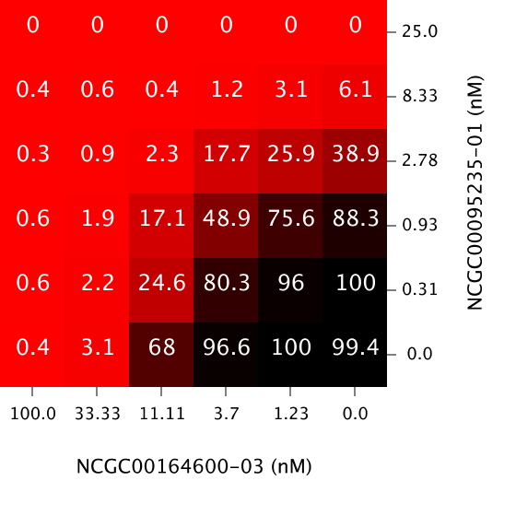
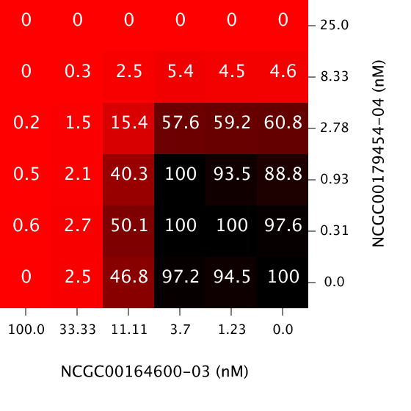
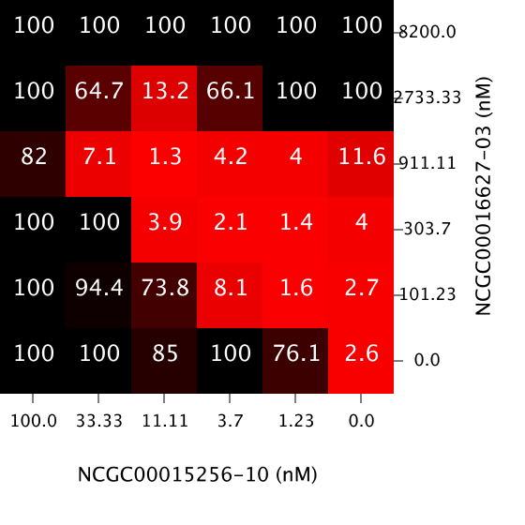
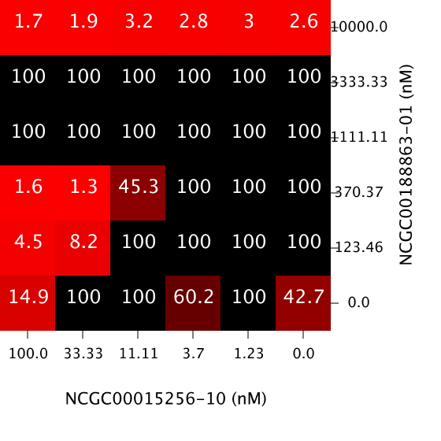
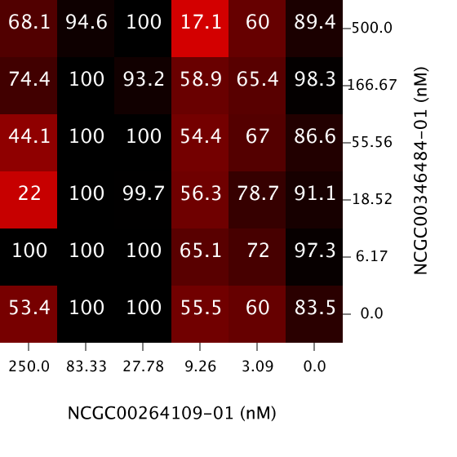
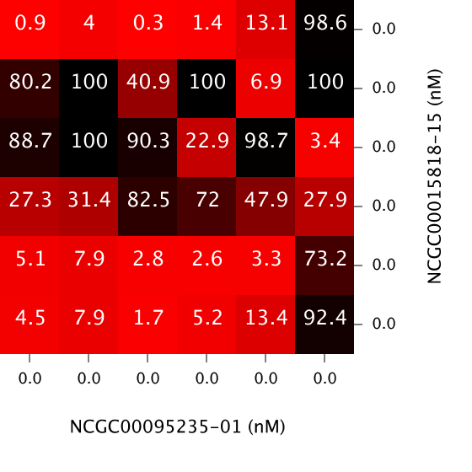
QC Score
QCS = 0
Depends on multiple subjective thresholds
Passes some poor quality blocks
Quickly filters out very bad combinations
False Negative
QCS = 2
QCS = 13

Slide 15
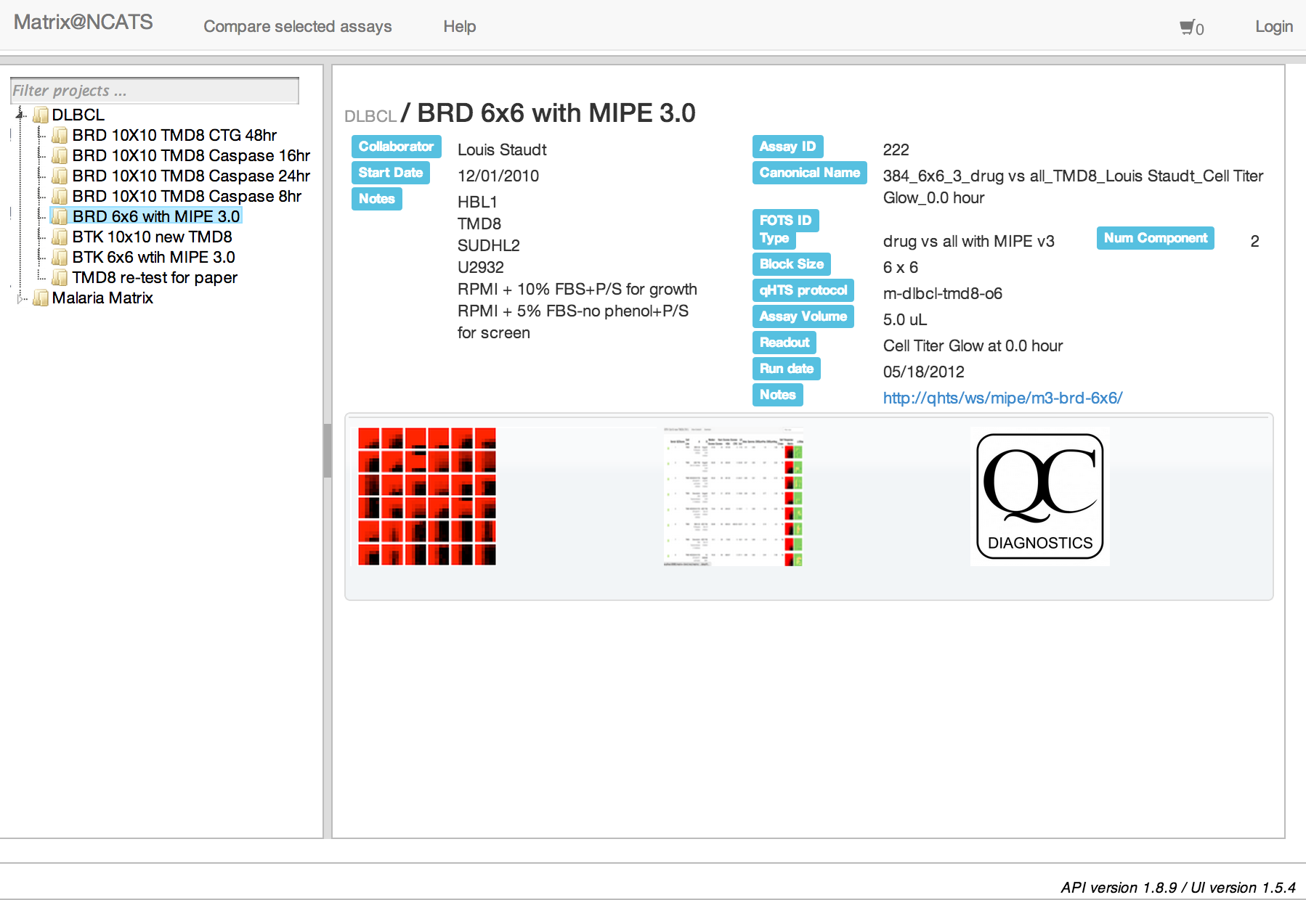
Reporting Combination Results

Slide 16
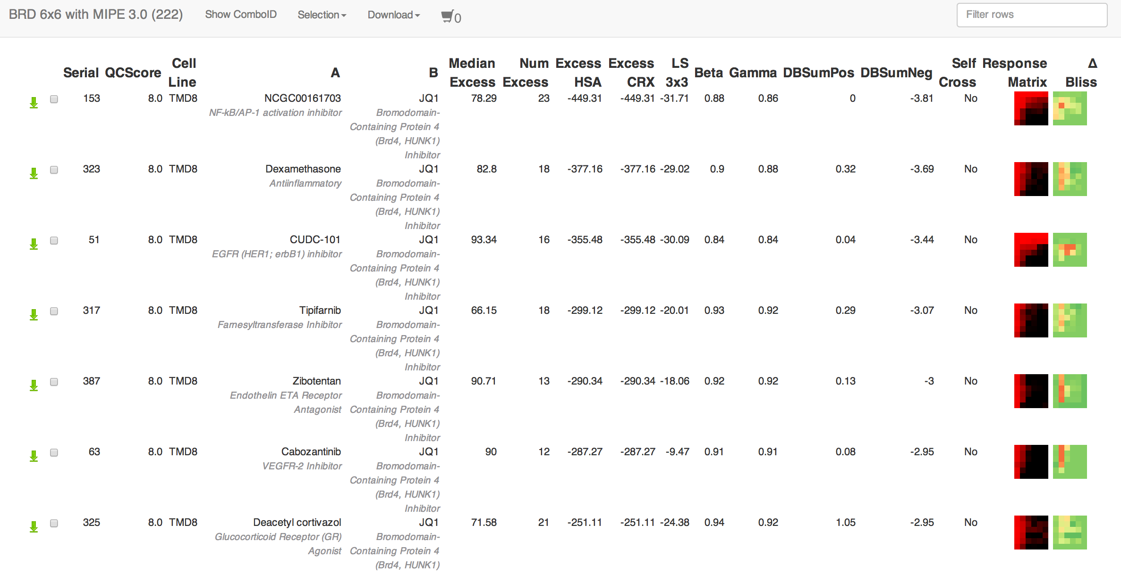
Reporting Combination Results

Slide 17
Reporting Combination Results
These web pages and matrix layouts are a useful first step
Does not scale as we grow MIPE
Need better ways of ranking and aggregating combination responses taking into account
Response matrix
Compounds, targets and pathways
Clinical status and other external information
Notes:
End goal is to be provide a comprehensive approach to selecting combinations for further study

Slide 18
Network Representations
Combination screens lend themselves naturally to network representations
Notes:
1 vs all screen lead to star networks – not overly interesting

Slide 19
Network Representations
Things get more interesting when we have n m screens
Can be simplified using a variety of methods
Neighborhoods
Minimum Spanning Tree

Slide 20
Comparing Neighborhoods
Combinations that have DBSumNeg < 1st quartile value for that strain
Notes:
DBSumNeg is the sum of the negative deviations from Bliss additivity – more negative corresponds to increased synergy
Quantify the neighborhood similarity based on a graph isomorphism approach
Blue is antimalarial, yellow is a signalling/transport, purple is PI3K/mtor inhibitor, cyan is a growth inhibitor

Slide 21
Comparing Neighborhoods
Alternatively, consider all tested combinations, highlighting distribution of synergistic and antagonistic combinations
Notes:
T

Slide 22
Identifying the Most Synergistic Pairs

Slide 23
When are Combinations Similar?
Differences and their aggregates such as RMSD can lead to degeneracy
Instead we’re interested in the shape of the surface
How to characterize shape?
Parametrized fits
Distribution of responses
Notes:
An alternative approach would be to fit the surface to a polynomial and then define similarity in terms of the parameter vector16

Slide 24
Similarity via the KS Test
Quantify distance between response distributions via KS test
If p-value > 0.05, we assume distance is 0
But ignores the spatial distribution of the responses on the concentration grid
Notes:
Ignoring spatial distribution leads to degeneracy

Slide 25
Similarity via the Syrjala Test
Syrjala test used to compare population distributions over a spatial grid
Invariant to grid orientation
Provides an empirical p-value
Less degenerate than just considering 1D distributions
Syrjala, S.E., “A Statistical Test for a Difference between the Spatial Distributions of Two Populations”, Ecology, 1996, 77(1), 75-80
Notes:
Lehar and the Combinatorx team have shown that specific target connectivities lead to response surfaces with specific forms
It is not unreasonable to assume that similar response surfaces might indicate similarity in the underlying connectivity
But of course, similar response surfaces can arise from multiple different connectivities

Slide 26
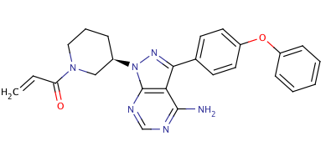
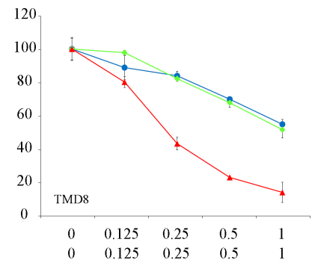
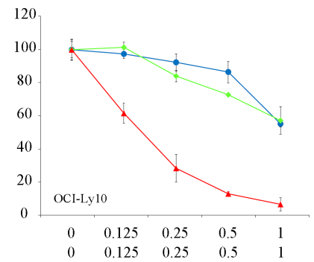
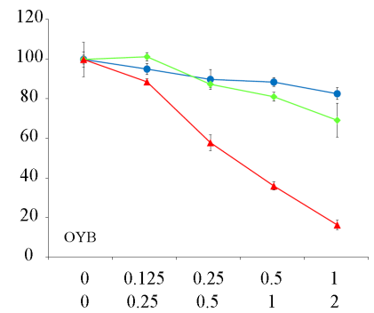
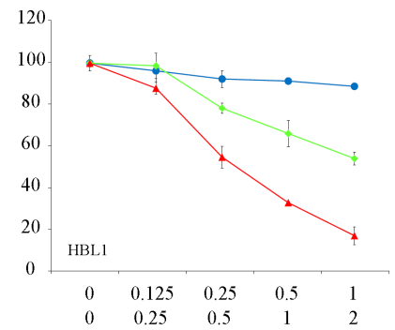
Ibrutinib Combinations For DLBCL
Primary focus is on investigating combinations with Ibrutinib for treatment of DLBCL
Btk inhibitor in Phase II trials
Experiments run in the TMD8 cell line, testing for cell viability
Viable
Cells
(% DMSO)
Ibrutinib
MK-2206
Ibrutinib* +
MK-2206
Ibrutinib* (nM)
MK-2206 (μM)
Mathews-Griner, Guha, Shinn et al. PNAS, 2014, in press
Notes:
(Activated b cell like) Diffuse large b cell lymphoma
Screening identified synergism with cmpds targeting PI3K (BKM-120), AKT (MK-206) and mTOR (everolimux) pathways

Slide 27
Clustering Response Surfaces
C1 (24)
C3(35)
C2(47)
C4(24)
Notes:
Given a distance matrix, we can now cluster combination responses
Interested in observing whether similarly shaped response surfaces are related to similar targets & pathways

Slide 28
Cluster C3
Vargatef, vorinostat, flavopiridol, …
Not particularly specific given the range of primary targets
Notes:
35 compounds
Vargatef, Vorinostat, flavopiridol, neratinib …
Similar GOBP enrichments to C2 not too surprising

Slide 29
Cluster C4
Focus on sugar metabolism
Ruboxistaurin, cycloheximide, 2-methoxyestradiol, …
PI3K/Akt/mTOR signalling pathways
Notes:
GO enrichments via compound targets is rough – lots of off target effects and these off target effects can be the driver in a combination response (vargatef example)

Slide 30
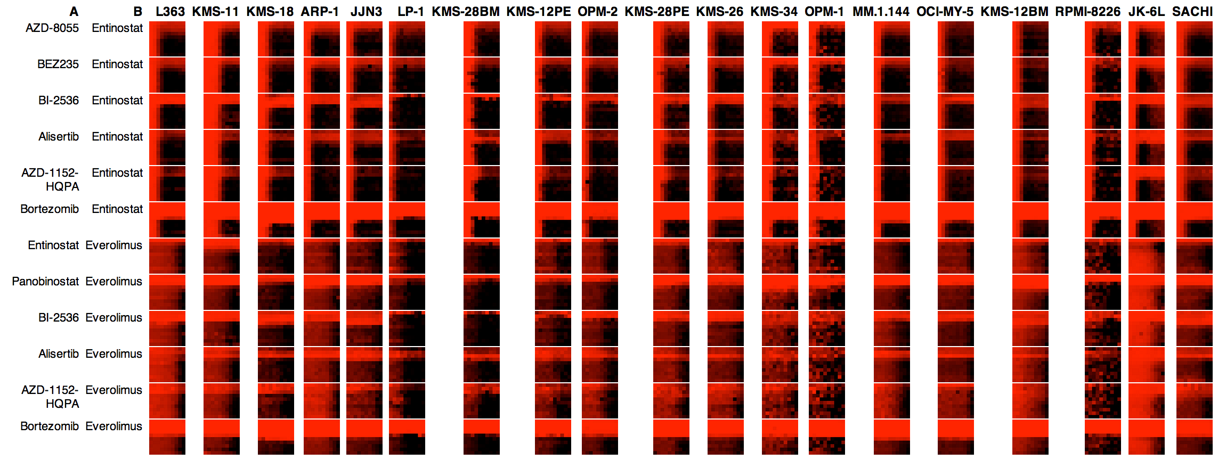
Combinations across Cell Lines
Cellular background affects responses
Can we group cell lines based on combination response?
Or find “fingerprints” that characterize cell lines?

Slide 31
Working in Combination Space
Each cell line is represented as a vector of response matrices
“Distance” between two cell lines is a function of the distance between component response matrices
F can be min, max, mean, …
L₁
L₂
,
= d₁
,
= d₂
,
= d₃
,
= d₄
,
= d₅

Slide 32
Many Choices to Make

Slide 33
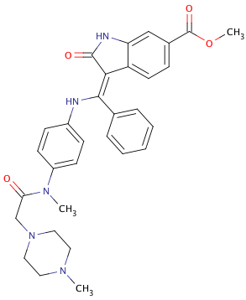
Exploiting Polypharmacology
Vargatef exhibited anomalous matrix response compared to other VEGFR inhibitors
Vargatef
Notes:
Is it similar to other agents with different targets?

Slide 34
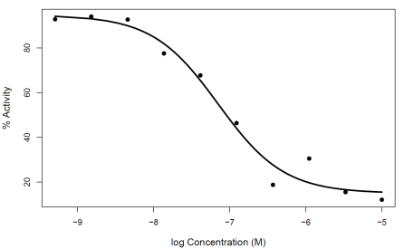
Exploiting Polypharmacology
PD-166285 is a SRC & FGFR inhibitor
Lestaurnib has activity against FLT3
Chk1 IC₅₀ = 105 nM
Hilberg, F. et al, Cancer Res., 2008, 68, 4774-4782
Notes:
If we assume that response surfaces are proximally related to target interactions, and not a function of downstream network effects - a weak assumption - some of these make sense
Vargatef falls in this cluster – mixture of MoA’s. AZD 7782 andPF 477736 are Chk1 inhibitors, GDC 0941 is a PI3K inhibitor,DCC 2036 is an ABL inhibitor.
These are reported off-targets for Vargatef (ie Since the report off target effects include SRC and FGFR, the vargatef matrix could be driven by those. But there is no reported OTE against Chk1)
But no reported activity against mTOR, IKK, Chk1/2, …

Slide 35
Predicting Synergies
Related to response surface methodologies
Little work on predicting drug response surfaces
Peng et al, PLoS One, 2011
Jin et al, Bioinformatics, 2011
Boik & Newman, BMC Pharmacology, 2008
Lehar et al, Mol Syst Bio, 2007 & Yin et al, PLoS One, 2014
But synergy is not always objective and doesn’t really correlate with structure
Notes:
Zhao et al (http://www.ploscompbiol.org/article/info%3Adoi%2F10.1371%2Fjournal.pcbi.1002323) also try to predict useful/good combinations based on pre-existing combnations, but does not get to predicting combination responses
But there has been a good amount of work on predicting properties of mixtures

Slide 36
Structural Similarity vs Synergy
Notes:
No correlation between structural similarity of pairs and the synergy measure for that pair
Interestingly, distinct patterns for different projects
Precludes predicting synergy measures from structure

Slide 37
Prediction Strategy
Don’t directly predict synergy
Use single agent data to generate a model surface
Predict combination responses
Characterize synergy of predicted response with respect to model surface
Reduced to a mixture prediction problem
Need to incorporate target connectivity

Slide 38
Conclusions
Use response surfaces as first class descriptors of drug combinations
Surrogate for underlying target network connectivity (?)
Response surface similarity based on distributions is (fundamentally) non-parametric
Going from single - chemical space to combination space opens up interesting possibilities
Manual inspection is still a vital step

Slide 39
Acknowledgements
Lou Staudt
Beverly Mock, John Simmons
Lesley Griner, Craig Thomas, Marc Ferrer, Bryan Mott, Paul Shinn, Sam Michaels

